Slide 1
Java Workshop 3 – Control Structures (Selection and Repetition)
This PowerPoint is the structure which controls the flow of this workshop
Ben Schwarz

Slide 2
Lesson Outline
Learn Binary (if) and Multi-way (switch) selection in Java
Basic Scope
Learn Pre-test loops (while & for loops)
Learn Post-test loops (do-while)

Slide 3
Control Structure – What and Why?
Up until now your code has been all a bit too… predictable.
When we refer to a control structure, we’re referring to something that alters the normal flow of a program.
No decision making leaves your programs as glorified calculators. Being able to control what your program does based on data makes it far more flexible.

Slide 4
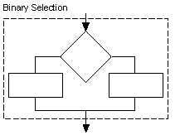
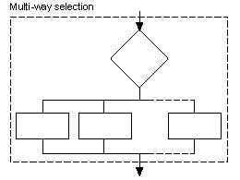
Selection Types
Binary – two options. In Java this is an if-else statement.
Multi-way – any number of options. In Java this is a switch statement.

Slide 5
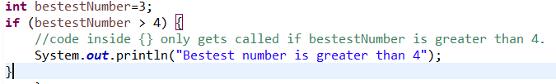
If statements
If statements will only run code if a condition is true
Example:

Slide 6
If statement broken down
This is the condition. If it is true the code in the block (code surrounded by curly brackets) is called.
The condition could be an expression like above or just simply a Boolean such as a variable.

Slide 7
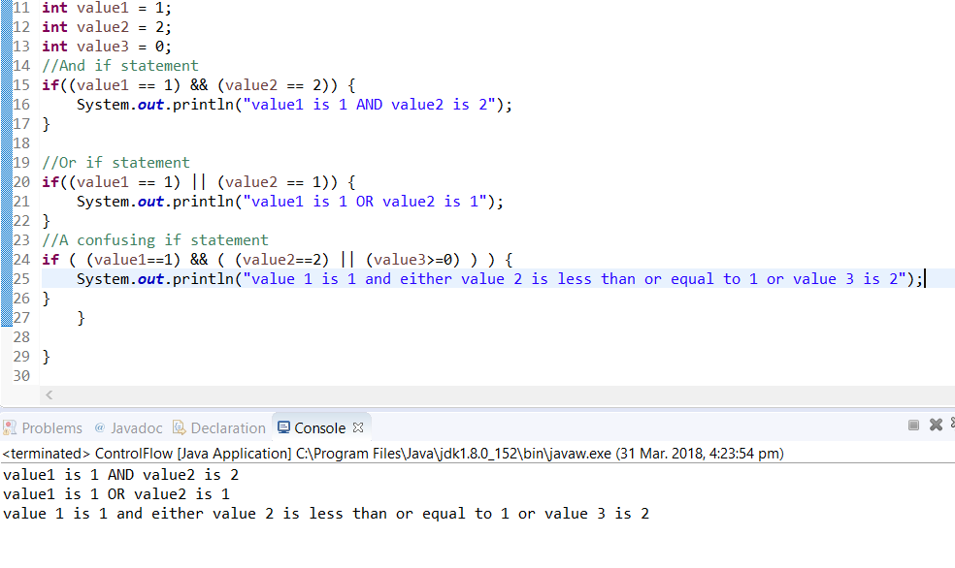
AND/OR operators
Sometimes you want to check for multiple statements being true or if one of multiple statements are true.
&& - and. True if all conditions are true.
|| - or (Shift+Backslash). True if any condition is true.
Note that you can chain statements together and they follow BODMAS.

Slide 8
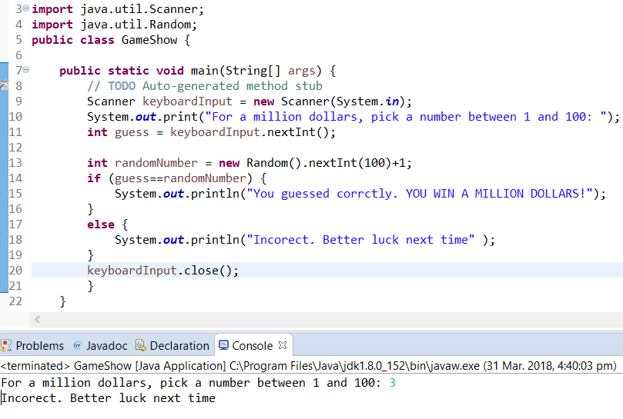
If/Else
Sometimes you want to run code if the if statement is false. Like a fork in the road.
Here we use an else statement. Example:

Slide 9
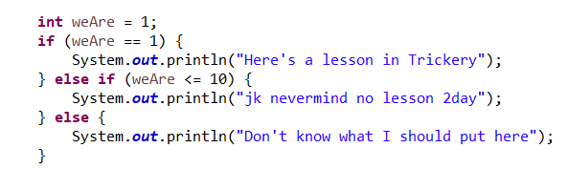
Else if
I can probably show this with an example better than some long explanation. See:
As you can see it would currently trigger at first. BUT if weAre = 8, then it would trigger at the second, else if, option. BUT if it was like 4613, then it would trigger at the last, else, statement

Slide 10
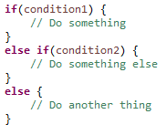


Syntax Overview – If-else Statements
Conditions must be boolean expressions
else if can be chained indefinitely
Anything can go inside the new code block, including more control structures
Indentation increases by one tab, to the level of the comments shown

Slide 11
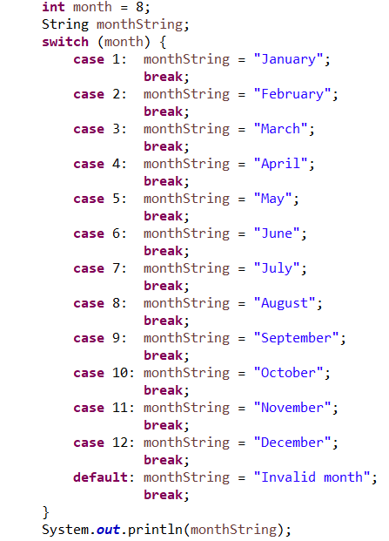
Switch Statements:
Sometimes you want to select from lots of different options. Example:

Slide 12
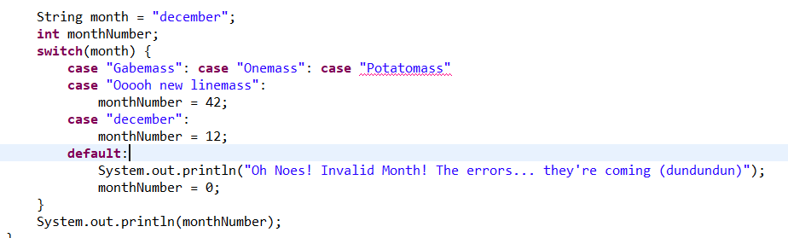
You can also use Strings to switch or Enumerations (which are fancy and for later)
Unfortunately, this always returns 0 and prints out the error message. Why? The "break;" was forgotten! The "break;" is really important, without it the program 'falls through' and start executing the next cases. So the monthNumber get's set to 12... but then it keeps on running, prints out the error message, and sets the number to 0. You need to include "break" to remind Java to stop executing the next cases.
As shown above, you can have multiple cases run the same block. "Gabemass", "Onemass", "Potatomass" and "Ooooh new linemass" would all get a monthNumber of 42.
Everything in a switch statement can be done with ifs. It's just a judgement call as to what's more appropriate, makes sense, looks nice, and fits in line with what you're trying to do.

Slide 13
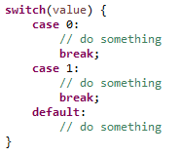
Syntax Overview – Switch Statements
The switch value must be an integer or String
Any case not handled specifically falls under the default case
Omitting break causes the switch to keep running the code in subsequent cases

Slide 14


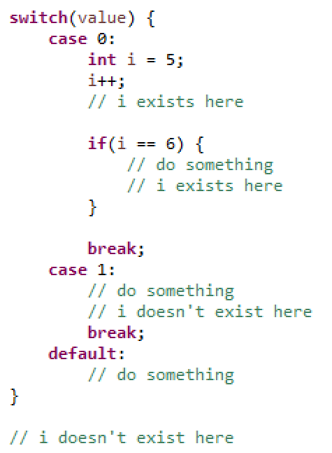
Scope - Variable Accessibility
A variable can only be used inside the block of code it is defined in, or other blocks of code that it contains.
Outside that block, it functionally doesn’t exist – you can even create a new variable with the same name.
If you want to maintain the value of a variable first used in an inner block of code, you have to declare it before entering that block.

Slide 15
Your Turn
Print the absolute value of a given number (without Math.abs).
If we define ‘long’ strings to be strings with more than 32 characters, and ‘short’ strings to have less than 8, write a program which prints out whether a string is short, normal or long.
Using a switch statement, print “Hi” if a string is equivalent to “Hello”, “Bye” if it is “Goodbye” and “I don’t understand” if it is anything else.
Without adding any more prints, modify the above program to also respond to “Hi” and “Bye.
Print the numbers from 1 to 5 that are above a given number in the same range, one per line. Do not use the newline char, and do not use more than 5 prints.
Ask someone their favourite colour. Make a judgement as to if they have a chosen a correct favourite colour, and inform them of if they get their decision wrong.
Hints:
The absolute value is the size of the number, e.g. the absolute value of both 2 and -2 is 2.
Problems 3 and 4 should be done without storing an output as a variable – you’re being tested on understanding of the switch statement.
Problem 5 uses a single switch statement. Consider an input of 5 first.

Slide 16
Often we want to repeat things.
For example let’s say we had instructions for eating cereal. It would look something like:
Put cereal in bowl
Add milk to cereal
Dip spoon into cereal and milk and then place spoon in mouth.
Repeat step 3 until all cereal and milk is eaten
Rinse bowl and spoon
Using iteration makes this algorithm possible.

Slide 17
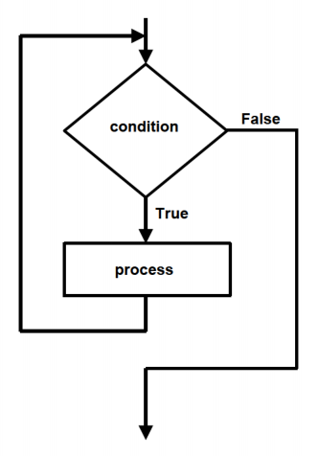
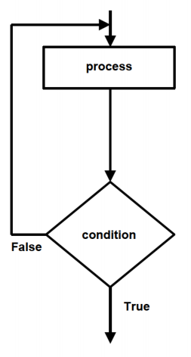
Repetition Types
Pre-test – If a condition is true, executes a block of code, then repeats. In Java this is either a while loop or a for loop.
Post-test – Executes a block of code, then repeats if a condition is true. In Java this is a do-while loop.
Pre-test Repetition
Post-test Repetition
Image source: BOSTES Software Design and Development 2012 Syllabus

Slide 18
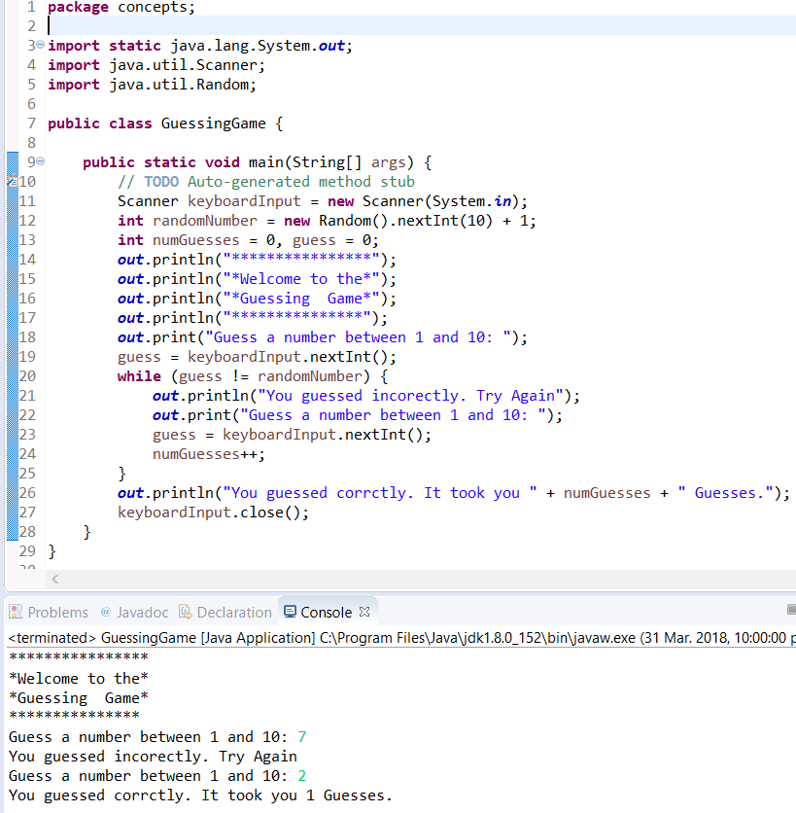
While loop
A while loop runs a block of code if a condition inside a parenthesis is true (like an if statement). Here is a example:
Note: the static import you won’t understand for now but the explanation is that out isn’t a class but a static field in the System class. This will make sense later. This saves space as I don’t have to write System.out.
It is possible to make a while loop run forever. But you should avoid it.

Slide 19

Syntax Overview – While Loops
Conditions must be boolean expressions
As with the selection control structures, anything can go inside the new code block, including more control structures
Be careful not to accidentally create endless loops – the condition should change value
Activity: Make a while loop that counts to 4613 and outputs it’s progress.

Slide 20

For loop
Now loops are also useful for counting things. You can use while loops to count up things, as you did with Activity 1. But there is in fact a better way. That better way is called a for loop!
They're quite a bit more complicated than while loops syntax wise. Look at the example, try to figure out what's happening, and then I'll deconstruct it.

Slide 21


Syntax Overview – For Loops
First part is run before first iteration – usually this is an assignment or declaration
Second part is the condition, which is checked before every iteration
Third part is run after every iteration, before the condition is checked again – usually this is an incrementor
Multiple statements can be put in the third part with a comma
Avoid overcrowding the header, to maintain readability
Iteration:
Generic:

Slide 22

Syntax Overview – Do-while Loops
Always executes once before checking the condition
Usually used when the first execution either allows the condition to be checked, or is required to have executed by later code

Slide 23
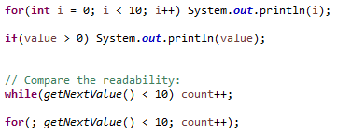
Single-line Control Structures
For simple selection or repetition control structures, it is often clearer to omit {}.
Only works on control structures with a single-line of code, i.e. to the next semicolon
An immediate semicolon indicates that no code is run
Should never be used as an excuse to complicate a for loop header

Slide 24
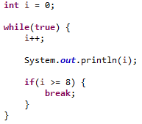
Break
Break overrides the ending condition of a loop and ends it immediately.
Almost always an example of bad program design
Carefully chosen loop conditions are preferable whenever possible

Slide 25
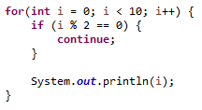
Continue
Continue skips to the next iteration of a loop.
More widely accepted than break
Can often be bypassed by enclosing the main section of a loop in a selection control structure
Useful as “guards”

Slide 26
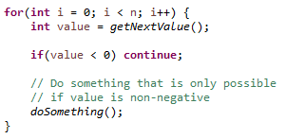
Guards
A guard in a loop prevents subsequent execution if certain requirements aren’t met.
Large if-statements can be used, but increase layering of code
Single-line continues should be used in a readable manner at the beginning of the loop

Slide 27
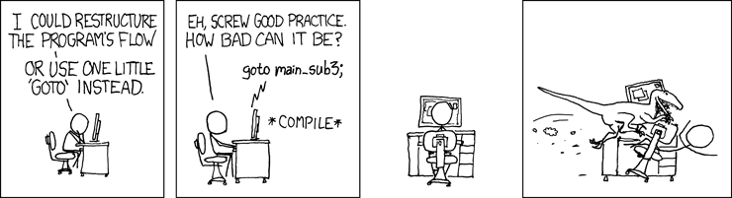
Goto
There are some… alternative facts ways to jump around in code.
These are break and goto. However, they have the tendency to make code messy, unreadable and make spaghetti code (convoluted code with a broken and impossible to understand structure).
Goto actually used to be in Java, but got removed because it's so bad. Goto lets you jump to specific lines of code. Break will exit a loop. Continue will begin the current loop again.
*One should try to avoid break where possible as well.
Not only are goto’s and other horrors bad, but we are legally obligated to warn you that it is a major OSHA healthplace work and safety hazard:

Slide 28
Your Turn
Print every number from 1 to 10
Print every number divisible by 7 between 254 and 1678
Determine the first number that is a multiple of 7, has a remainder of 5 when divided by 8, and a remainder of 11 when divided by 13
Print 2 to the power of every number from 0 to 10
Print the first 7 numbers that meet the conditions of (3)
Do (4) with only one loop
Hints:
Remember the % operator
Powers are the same as multiplying repeatedly
You may find a variable that counts how often something has occurred useful
They are all doable without continue

Slide 29
Homework
If we list all the (positive integer) numbers below 10 that are multiples of 3 or 5, we get 3, 5, 6 and 9. The sum of these multiples is 23. Find the sum of all the multiples of 3 or 5 below 1000.
The Fibonacci sequence is generated by adding the previous two terms to create the next term. Starting with 1, it goes 1, 1, 2, 3, 5, 8, 13, 21, 34, 55, 89. Find the sum of numbers in the Fibonacci Sequence, that are less than four million, and are divisible by 8.
Find the 4613th prime number.
Extension: Make a calendar program which will output what the current day of the week is from the date - Wikipedia has several methods, see https://en.wikipedia.org/wiki/Determination_of_the_day_of_the_week#A_tabular_method_to_calculate_the_day_of_the_week . Note that a (whole) number % 100 will return the last two digits (10s and 0s). (FYI you can have people enter in the date separately - i.e. ask the day, month and year.)

Slide 30
Summary
You’ve learnt how to:
Make decisions using if statements
Make decisions using switch statements
Create variables in-scope.
Create while loops.
Create for loops
Create do-while loops

